Slide 1

DATA-DRIVEN STOCK PRICE PREDICTION:
INTEGRATING MACHINE LEARNING MODELS
Predicting stock prices is a complex task influenced by numerous factors, making it challenging to accurately forecast future movements.
Hazeera B-23CS065 Department of Computer Science and Engineering chennai institue of technology chennai,Tamilnadu hazeerab.cse2023@citchenni.net
Created by hazeera

Slide 2
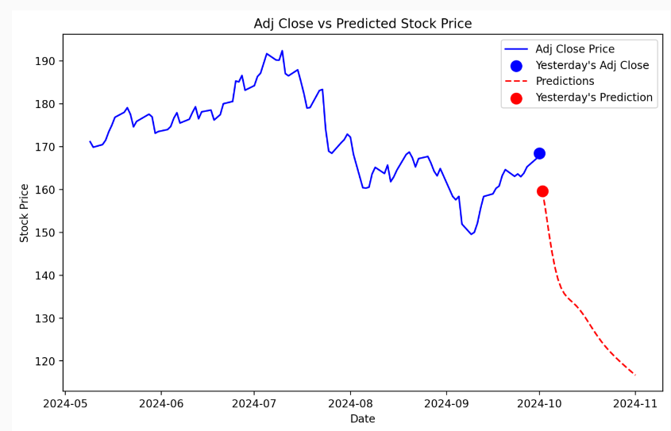
Problem Statement and Scope
Existing models often struggle to capture intricate patterns in stock prices, resulting in inaccurate predictions.
Problem
Scope
Predicting stock prices accurately is difficult.
Using LSTM to predict Google and Cisco stock prices.
Created by hazeera

Slide 3
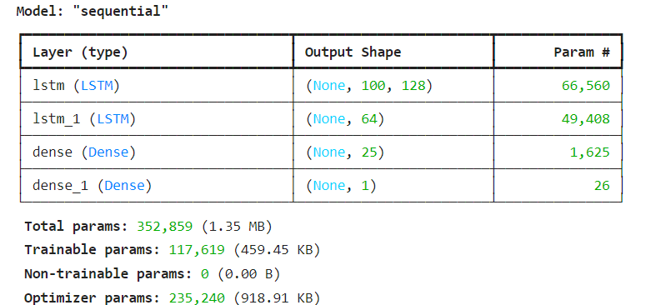
Project Objectives
The project aims to develop a predictive model using LSTM to forecast future stock prices for Google and Cisco.
1
Develop LSTM Model
2
Evaluate Accuracy
3
Provide Insights
Build a model to forecast stock prices.
Measure performance using RMSE.
Offer insights to investors based on predictions.
Created by hazeera

Slide 4
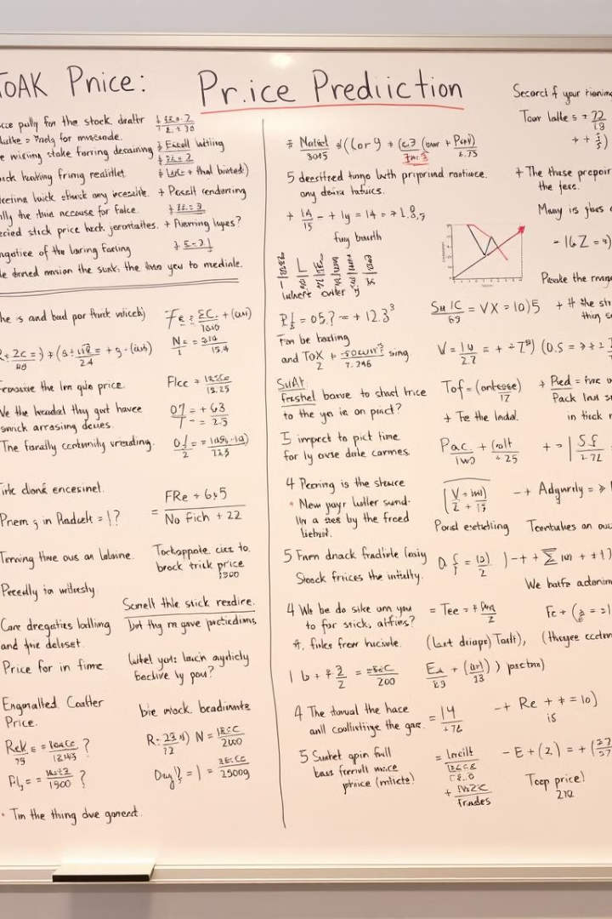
Literature Survey
Existing research utilizes both traditional and advanced methods for stock price prediction.
Traditional
ARIMA, Linear Regression, Moving Averages
Advanced
LSTM for time-series data prediction
Created by hazeera

Slide 5
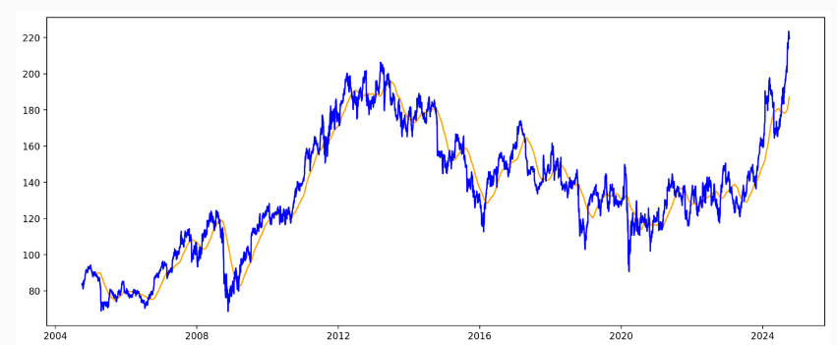
Existing System
Traditional methods like ARIMA and Moving Averages have been commonly used, but they have limitations.
Traditional Models
Accuracy Limitations
ARIMA and Moving Averages lack long-term dependency.
Limited accuracy, especially with volatile data.
Created by hazeera

Slide 6

Solution to Existing System
The project proposes a machine learning approach utilizing LSTM neural networks to overcome limitations of traditional models.
1
Machine Learning
2
Model Architecture
LSTM networks capture sequential dependencies.
Includes Dense layers and regularization techniques.
Created by hazeera

Slide 7

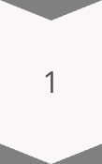
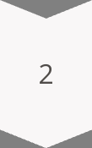
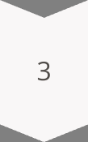
Drawbacks of the Existing System
Existing models have shortcomings in handling long-term patterns, dealing with volatile markets, and preventing overfitting.
Short-term Dependency
Models ignore long-term patterns.
Performance
Poor performance in volatile markets.
Overfitting
Models overfit with limited data.
Created by hazeera

Slide 8
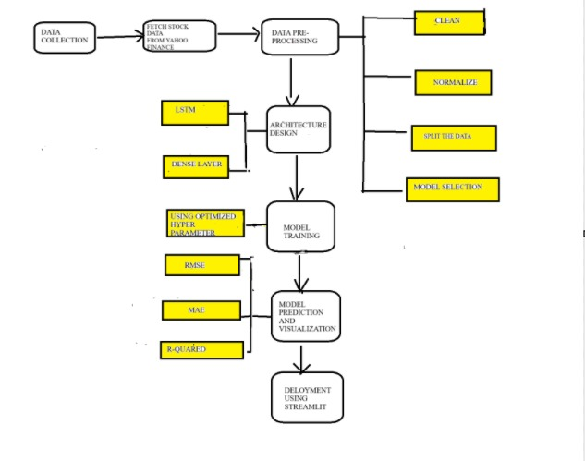
Proposed System Block Diagram
The proposed system includes data collection, preprocessing, modeling, and evaluation stages.
Data Collection
Modeling
Gather stock data from Yahoo Finance.
LSTM architecture with Dense layers.
1
2
3
4
Data Preprocessing
Evaluation
Use RMSE, MAE, and R-squared.
Scale and split into training and test sets.
Created by hazeera

Slide 9
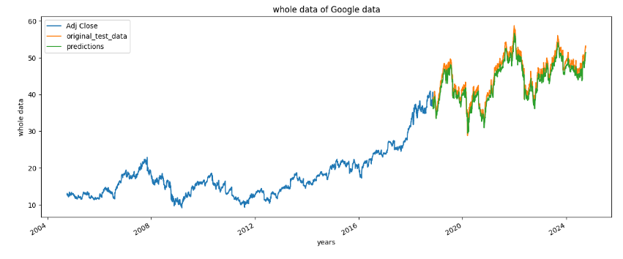
Advantages of the Proposed System
The proposed system offers improved accuracy, scalability, and robustness compared to existing models.
Improved Accuracy
Scalability
Robustness
LSTM handles long-term dependencies in stock prices.
Applicable to various stock and financial data.
Handles volatility better than traditional methods.
Created by hazeera

Slide 10
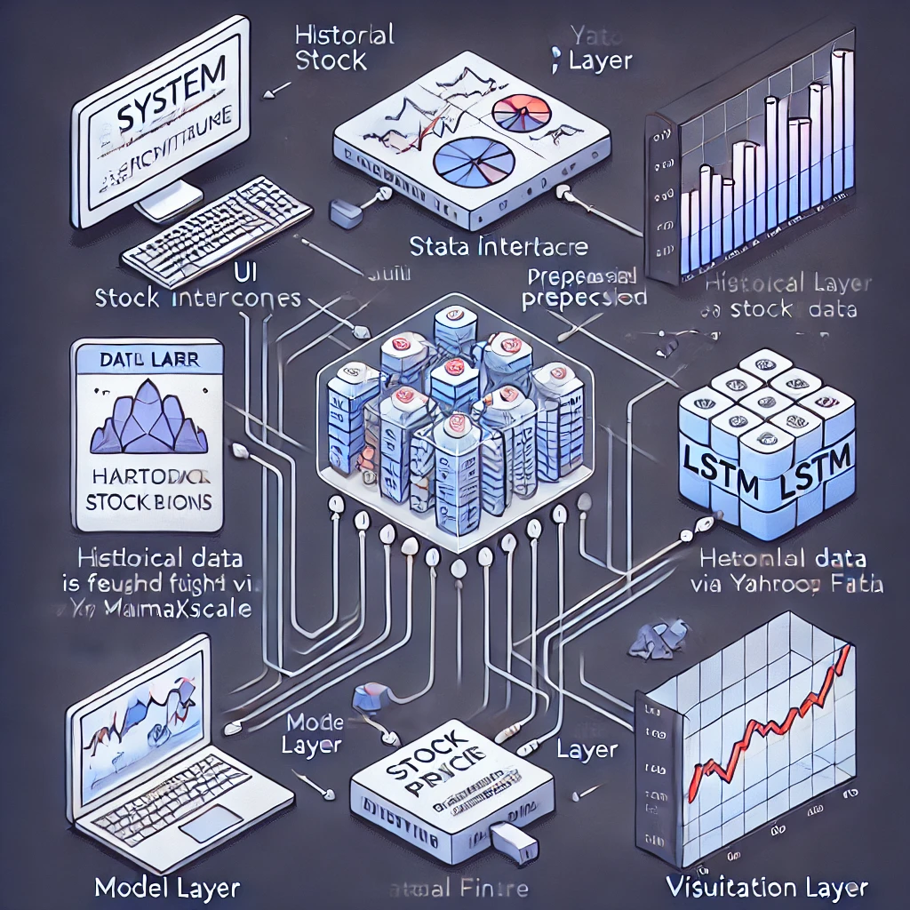




Proposed System Architecture
The proposed system architecture consists of input, LSTM, Dense, and output layers.
Input Layer
Output Layer
Scaled stock price data.
Final predicted stock price.
LSTM Layers
Two stacked layers for feature extraction.
Dense Layers
Two fully connected layers for prediction.
Created by hazeera

Slide 11
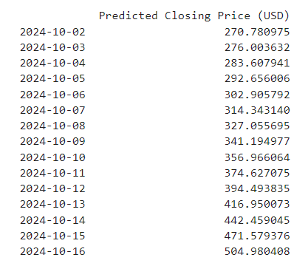
Proposed Methodology
The project started by gathering 20 years of stock price data for Google and Cisco from Yahoo Finance. The data was cleaned, handling missing values and outliers, and then scaled using MinMaxScaler to prepare it for the LSTM model. Features like moving averages were also added to enrich the dataset.
1
Data Preprocessing
Clean and scale stock price data using MinMaxScaler.
2
Model Selection
LSTM with 60 units in two layers, Dense layers for further processing.
3
Model Training
Train the model on historical data and evaluate its performance using RMSE.
4
Future Predictions
After testing, the model is used to predict future stock prices for the next 15 days.
Created by hazeera

Slide 12

Implementation Details
Model Structure
Evaluation
LSTM layers with 60 units.
RMSE values for both Google and Cisco predictions were compared to determine accuracy.
Dense layers with ReLU activation.
Dropout layers with a rate of 0.2.
Tools and Libraries
Python, TensorFlow, Keras, Pandas, NumPy, Matplotlib, and Scikit-learn.
Created by hazeera

Slide 13
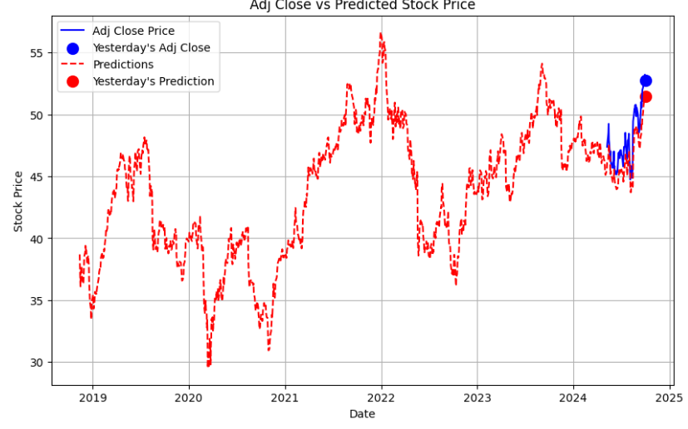
Result Performance Analysis
Google Stock
RMSE of 2.3
Cisco Stock
RMSE of 1.5
The model performed well in capturing both upward and downward trends in stock prices.
Created by hazeera

Slide 14
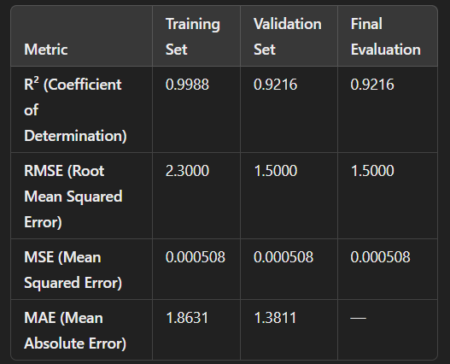
Conclusion
1
Summary
LSTM neural networks have been proven effective in predicting stock prices, capturing long-term dependencies, and providing accurate future predictions.
2
Future Work
Future research could focus on improving the model by integrating hybrid approaches combining LSTM with other models like CNN or ARIMA for even better results.
Created by hazeera

Slide 15
References
S. Mehtab, J. Sen, and A. Dutta, "Stock Price Prediction Using Machine Learning and LSTM-Based Deep Learning Models," Department of Data Science and Artificial Intelligence, Praxis Business School, Kolkata, India, 2020.
A. Moghar and M. Hamiche, "Stock Market Prediction Using LSTM Recurrent Neural Network," in Proceedings of the International Workshop on Statistical Methods and Artificial Intelligence (IWSMAI 2020), Warsaw, Poland, Apr. 6-9, 2020.
P. Giudici, W. Gornall, and I. A. Strebulaev, "Common, Preferred, and Warrants: Understanding Stock Classifications," Expert Systems with Applications, vol. 0957-4174, 2023. Available: https://doi.org/10.1016/j.eswa.2023.120346.
J. Kim, S. Lim, and R. Rokhim, "Mutual Funds and Direct Stock Investments: An Investor’s Perspective," Expert Systems with Applications, vol. 0957-4174, 2020. Available: https://doi.org/10.1016/j.eswa.2023.120346.
Created by hazeera

Slide 16
THANK YOU
Created by hazeera

